Slide 1

window

Slide 2
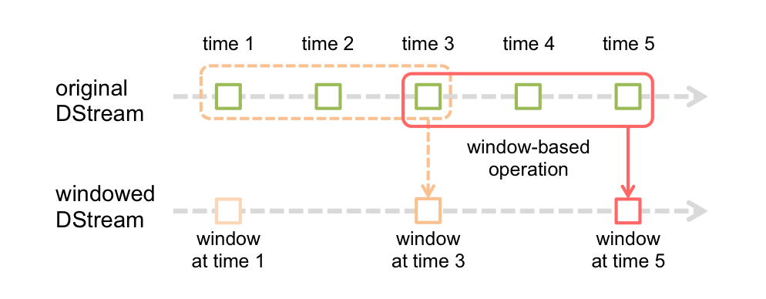
window() Overview
window(windowLength, slideInterval)
Return a new DStream which is computed based on windowed batches of the source DStream.

